Slide 1


Presented By: Alan Devkota
ECE 601
Feb 15, 2023
Department of ECE, University of Houston
Houston, TX, USA

Slide 2
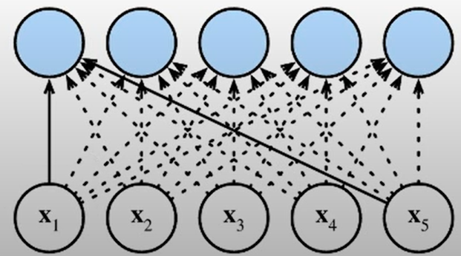
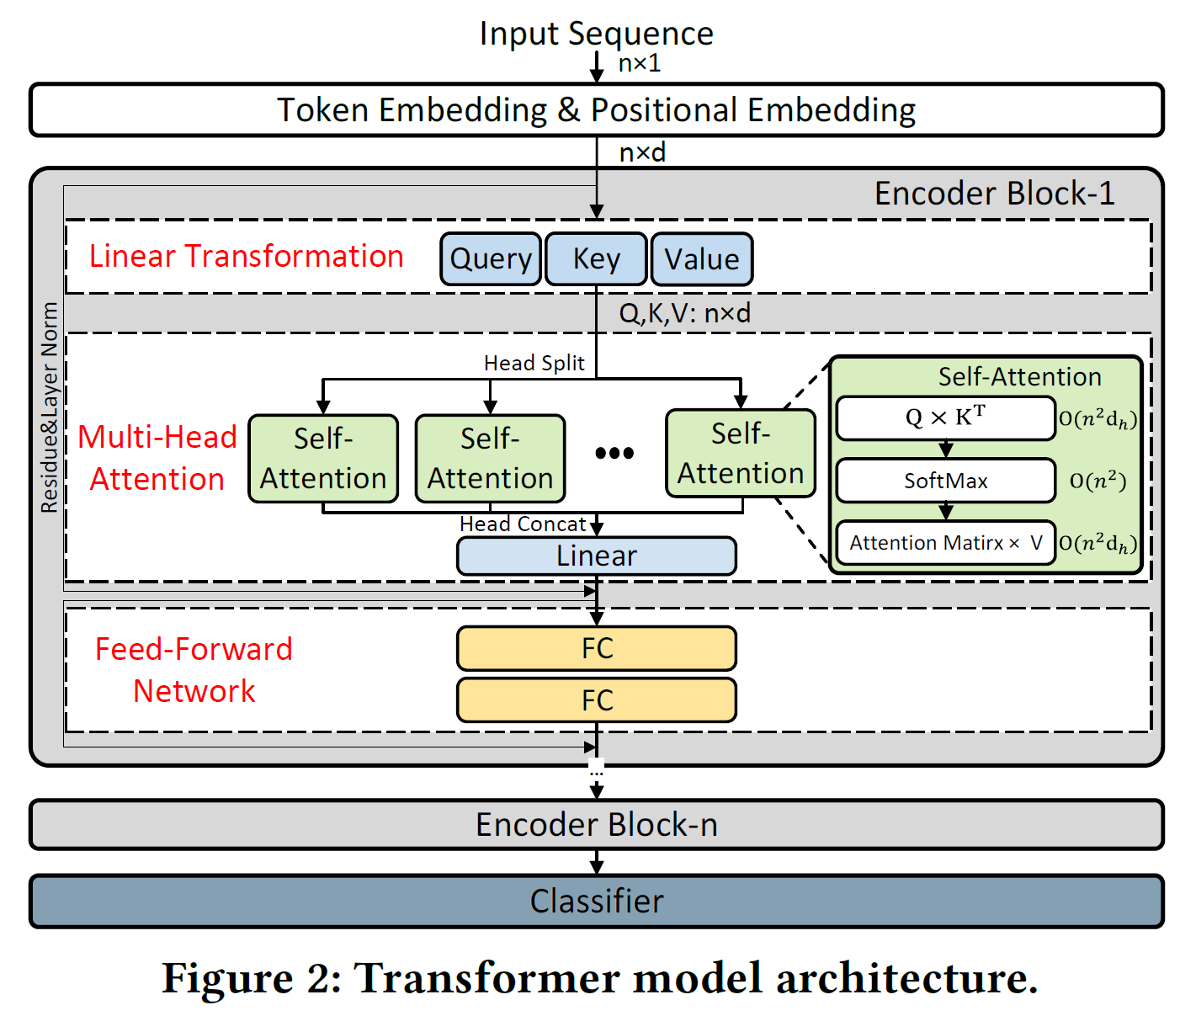
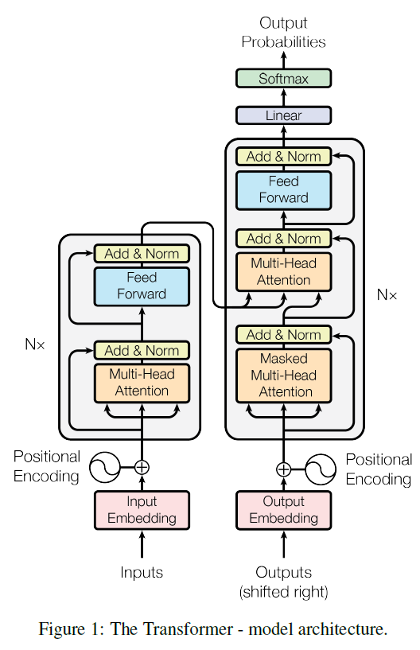
Transformer Neural Network
Cross-Attention
Self-Attention
Self-Attention
Model: Stack of encoder/ decoder blocks
Usually 3-Stage processing procedure: Linear transformation, Multi-head Attention and Feed Forward
Key Structure: Self-attention

Slide 3
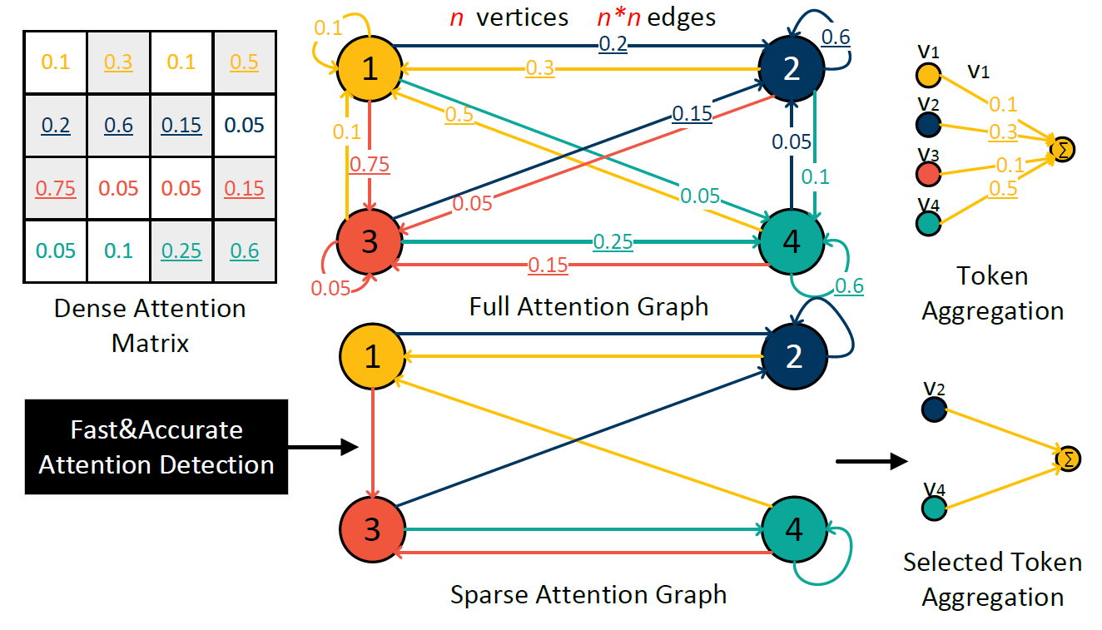
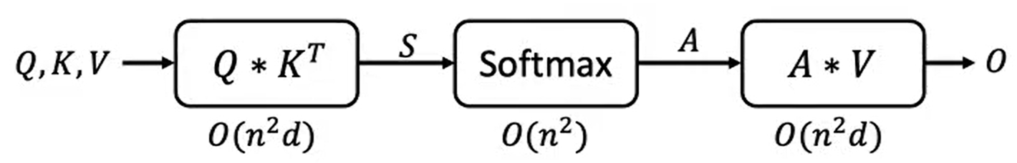
Self-Attention Mechanism
Self-Attention can be understood from a graph perspective.
Each token in the sequence could be regarded as a vertex.
Each directed edge represents the attention connection from vertex a to b, and edge weight represents attention weight
We can update each vertex’s feature by aggregating the information from its neighbors.
I like ECE Seminar

Slide 4
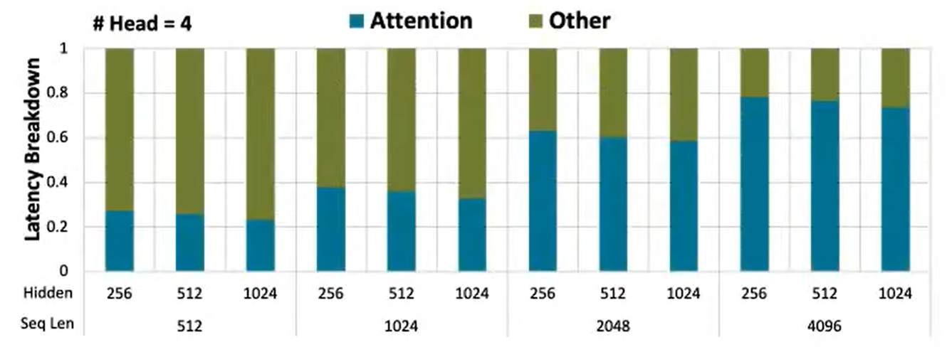
Motivation
Self-Attention Cost
Quadratically scaled complexity of self-attention → Bottleneck of executing long sequences
>73% of total execution time with a sequence length of 4096, 8.65GB peak memory usage under 32-bit floating point operation
Therefore, it is critical to reduce the cost of self-attention blocks.

Slide 5
Motivation
Sparsity
Repetition of the value “0” in weight or activations allows elimination of unnecessary computations.
Although GPUs are highly optimized in non-sparse dense matrix multiplication, they may not be efficient in reaping the full benefits of sparse matrix multiplication
Different layers of a neural network exhibit sparsity in unique ways, which necessitates specialized hardware due to variations in the computation nature.
I like ECE Seminar
Self-Attention have many weak connections that contributes very little to the final output of the feature aggregation!!

Slide 6
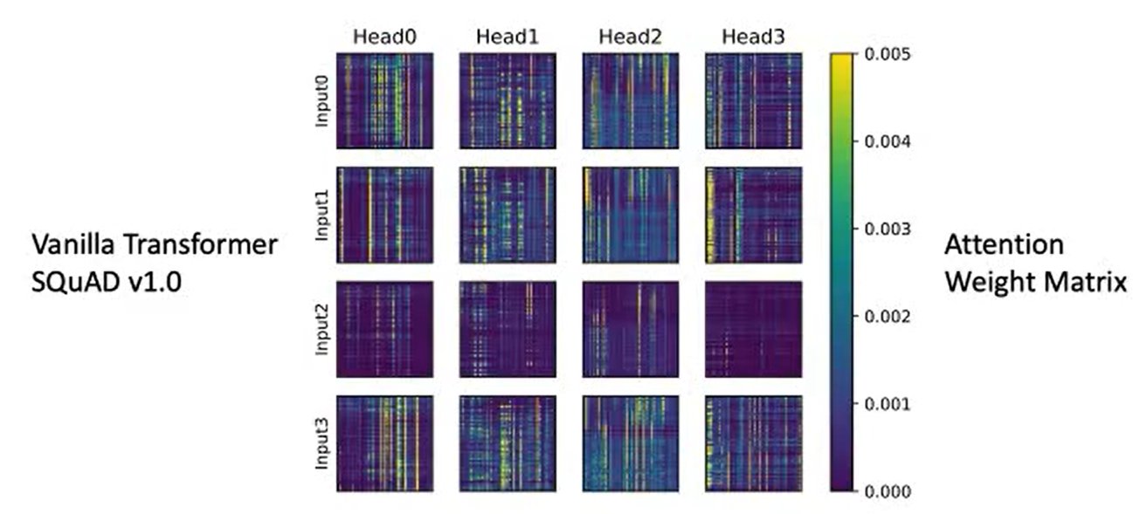
Opportunity: Dynamic Sparsity in Attention Graphs
Only very few attentions have weight value larger than 0.005
Model can achieve on-par accuracy while running on pruned sparse attention graph, which much reduced memory and computation
Self-Attention have many weak connections that contributes very little to the final output of the feature aggregation!!
Notes:
Attention weight matrix is dynamically changing depending on input sequence as well as different self-attention heads.
Attention sparsity → Dynamic

Slide 7
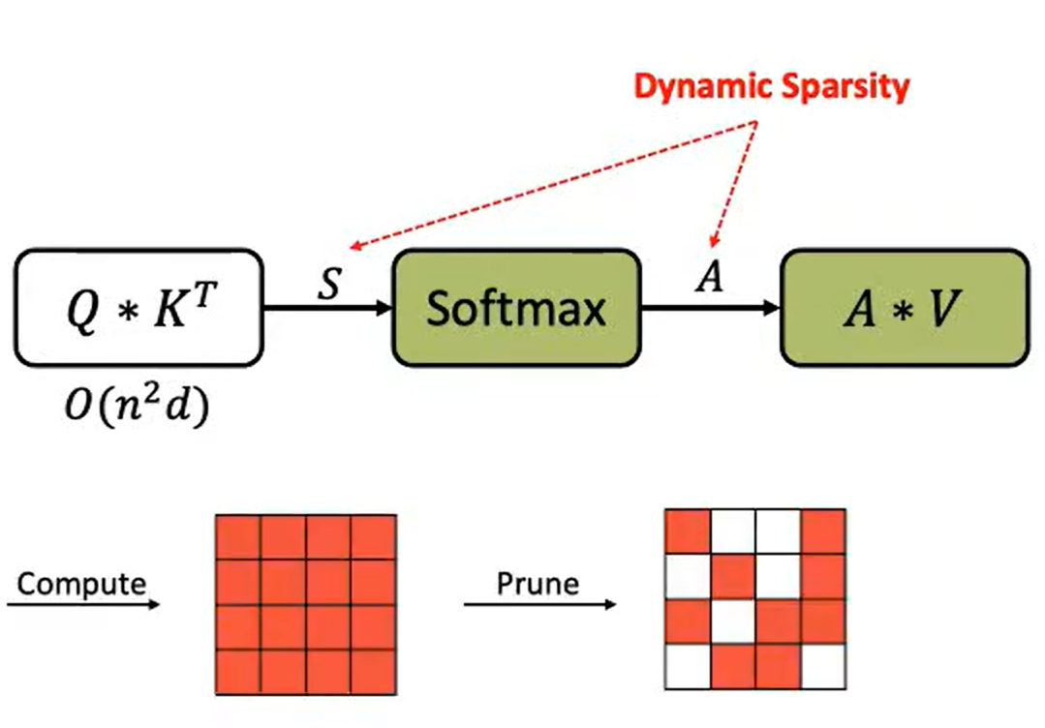
Challenges
How to locate weak attention connection?
(Compute A, Take A as a reference → compare and select only important ones.)
Requires computing the complete attention matrix!!
Notes:
Compute and prune method.
Some Redundancy

Slide 8
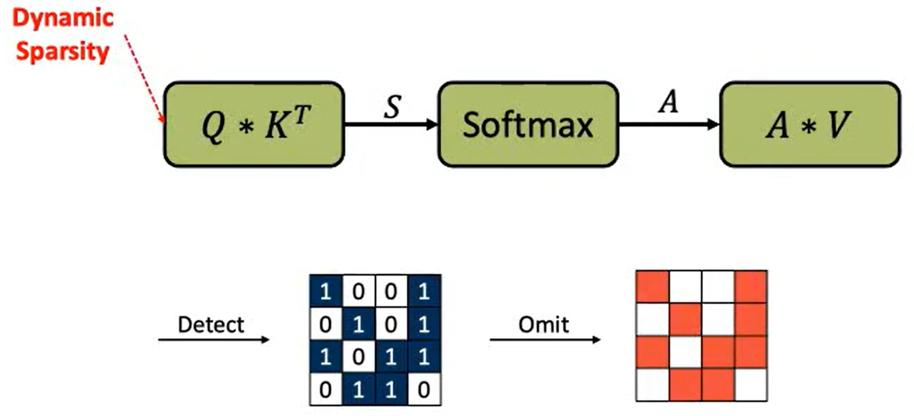
Challenges
How about introducing the sparsity before Q * K’ to obtain most computation/ memory reduction?
(Detect and Omit)

Slide 9
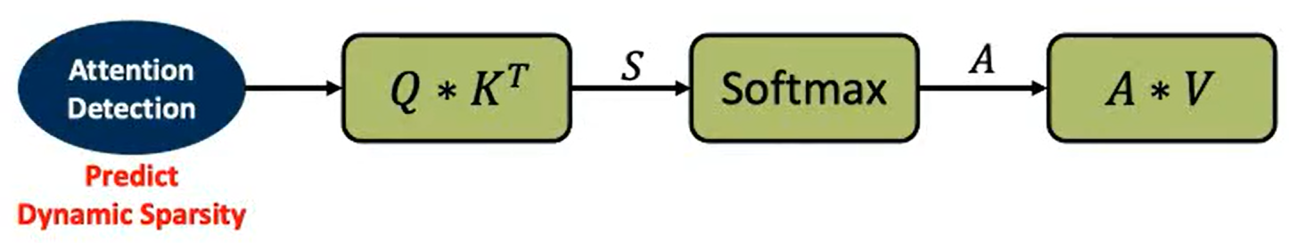
Challenges
How about introducing the sparsity before Q * K’ to obtain most computation/ memory reduction?
(Detect and Omit)
It requires some detection method!!
Should be light-weight, accurate and hardware-efficient (trade-off)

Slide 10
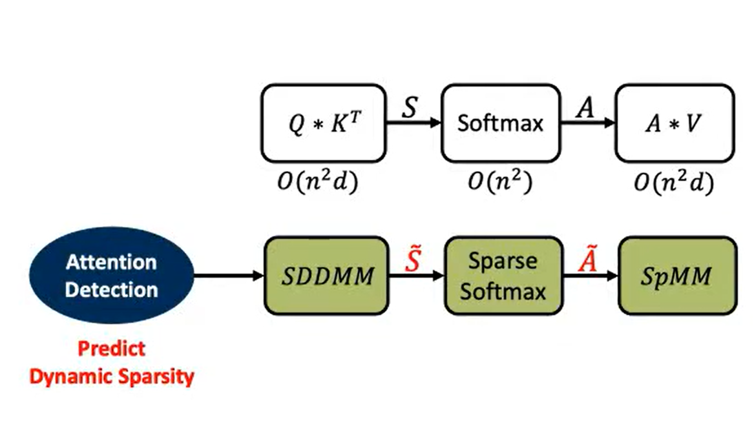
Hardware Challenges
Should support both detection and execution
Random projection
Quantization/ dequantization
Multi-precision computation
Should support sparse attention computation
SpMM
SDDMM
Sparse Softmax
However, some of the sparse operators are difficult to accelerate on GPU, so they have proposed customized architecture.
Notes:
Simple Dense-Dense Matrix Multiplication
Sparse Softmax
Sparse Matrix-Matrix Multiplication

Slide 11
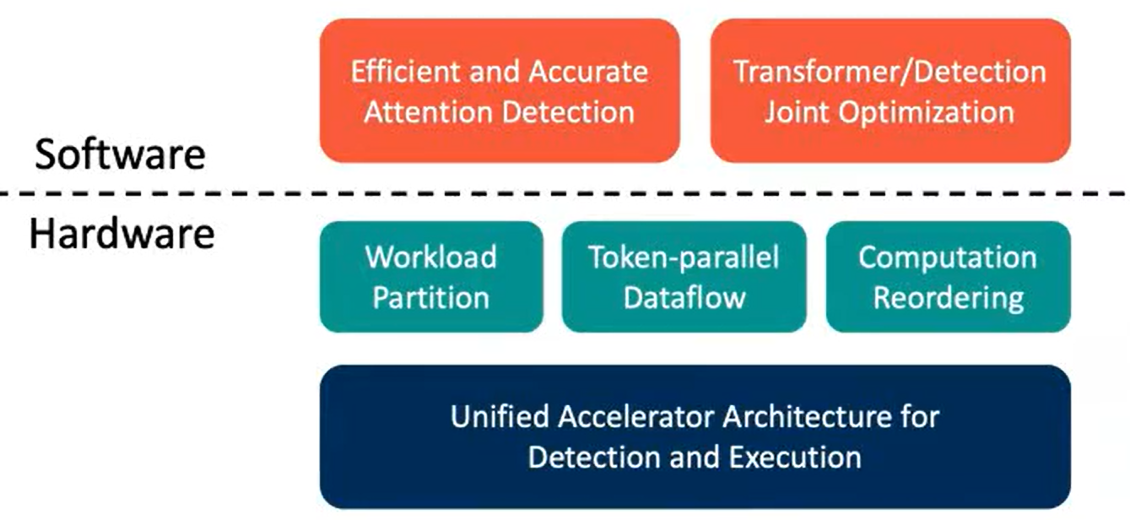
Solution: DOTA
Proposed top-down Software-hardware co design
On software side → Lightweight detection n/w along with optimization of transformer model
Hardware side → Different accelerator (on top of it workload partition, token-parallel Dataflow, and computation reordering)

Slide 12
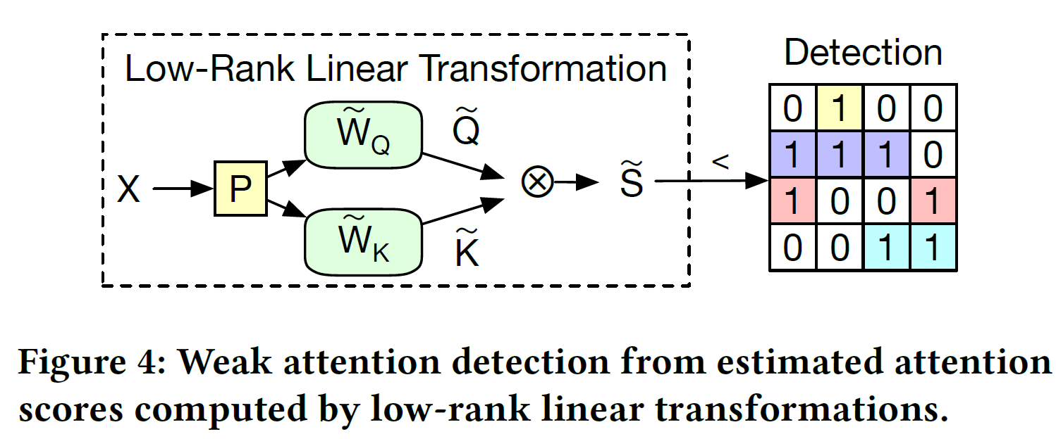
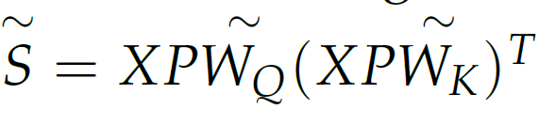
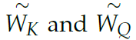
DOTA: Dynamic Sparse Attention Algorithm
Train a lightweight detection n/w to help detect the weak/important connection
Low precision and low dimension
Calculate approx. attention weight using expression
P is sparse random projection and
denote approx. weights for keys and queries
Use
to preserve or discard the attention scores
Notes:
Random projection, to reduce feature implement light weight detection network to obtain estimated attention scores.

Slide 13
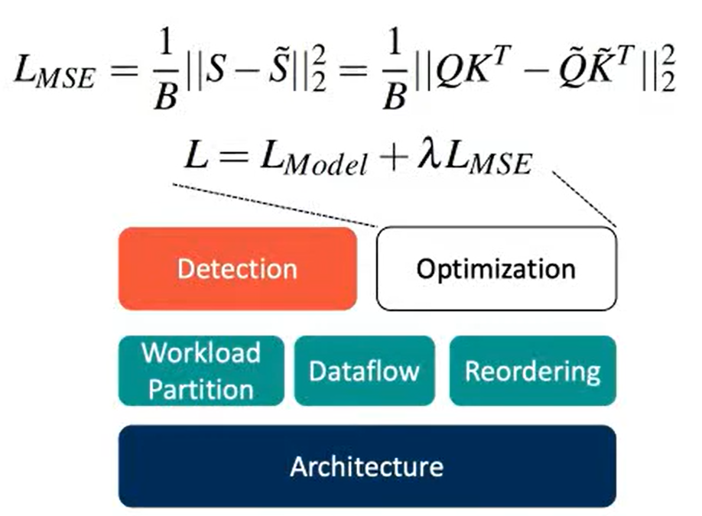
DOTA: Dynamic Sparse Attention Algorithm
Joint optimization of detector and transformer model to ensure detection accuracy and final model accuracy
Notes:
L_model → end-to-end model prediction loss
Lmse → mean square error between approx. attention score and actual attention score.
Lambda is hyperparameter to control the two loss.

Slide 14
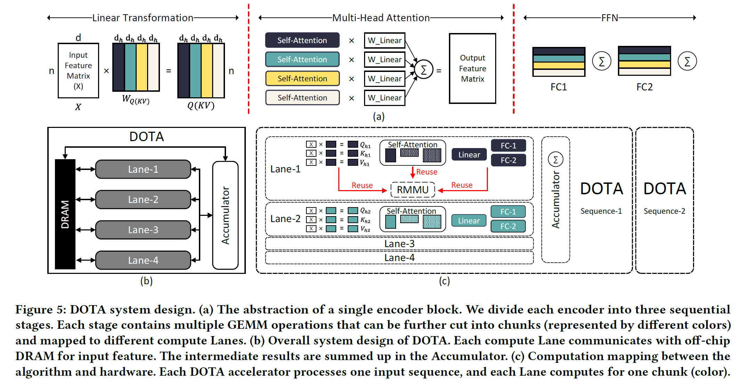
DOTA Accelerator Architecture

Slide 15
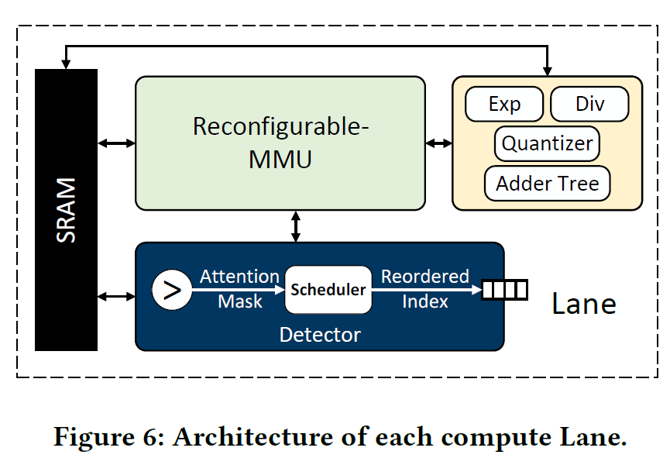
Compute Lane
Reconfigurable Matrix Multiplication Unit – Multi-precision computation
SRAM Buffer
Multi-Function Unit – Adder tree for random projection, (De)Quantization Unit, Exp/Div for Softmax function
Detector – Attention Detection, Hardware-level sparse computation scheduling

Slide 16
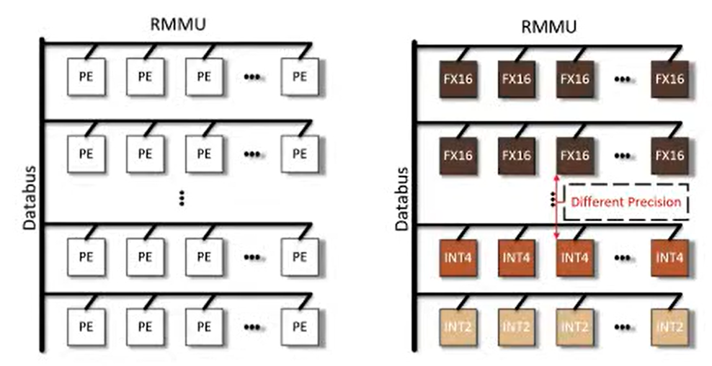
Reconfigurable MMU
2D PE array
One PE architecture, row-wise reconfigurable precision
Notes:
Used for all dot product operations.
Sometime more accurate, sometime light-weight

Slide 17
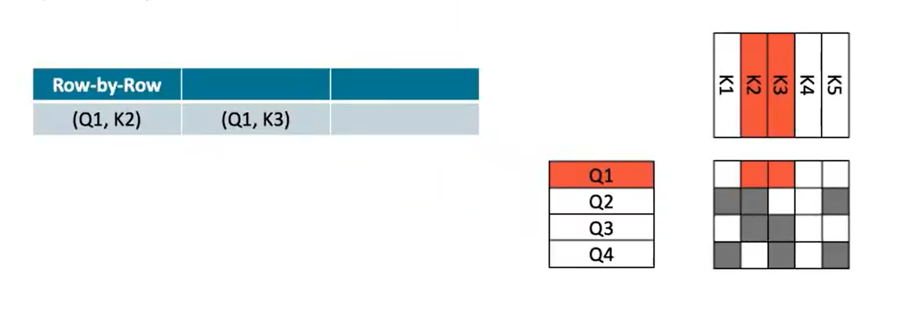
Token-Parallel Sparse Attention
Naïve way – compute the output matrix row by row, from left to right

Slide 18
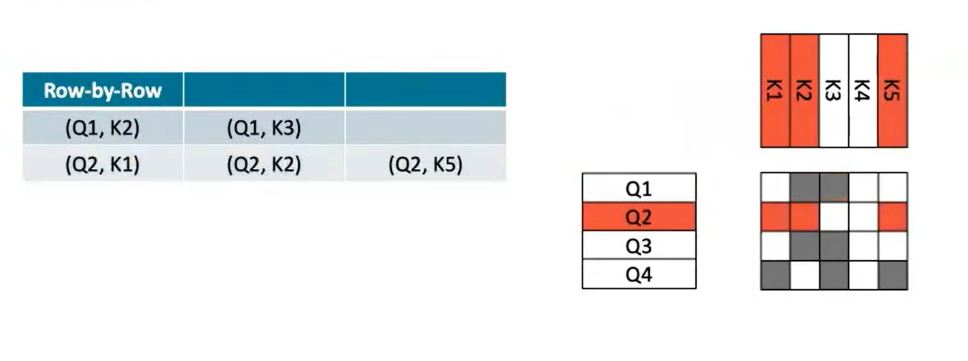
Token-Parallel Sparse Attention
Naïve way – compute the output matrix row by row, from left to right

Slide 19
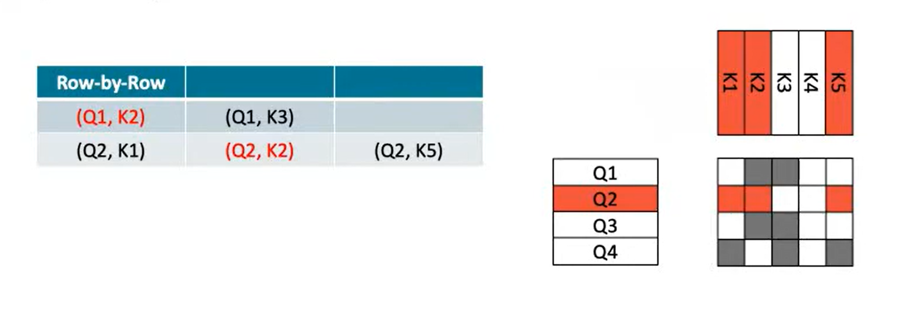
Token-Parallel Sparse Attention
Naïve way – compute the output matrix row by row, from left to right

Slide 20
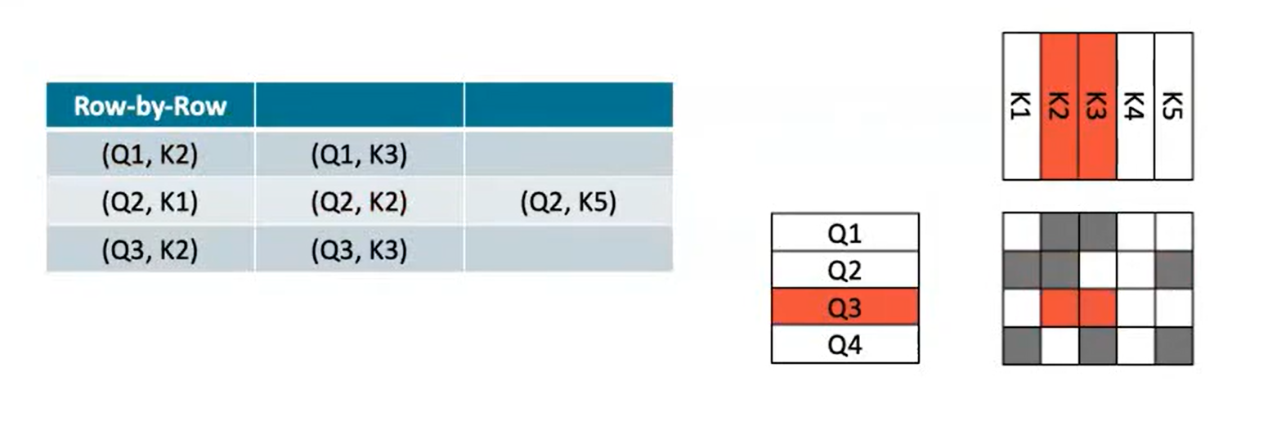
Token-Parallel Sparse Attention
Naïve way – compute the output matrix row by row, from left to right

Slide 21
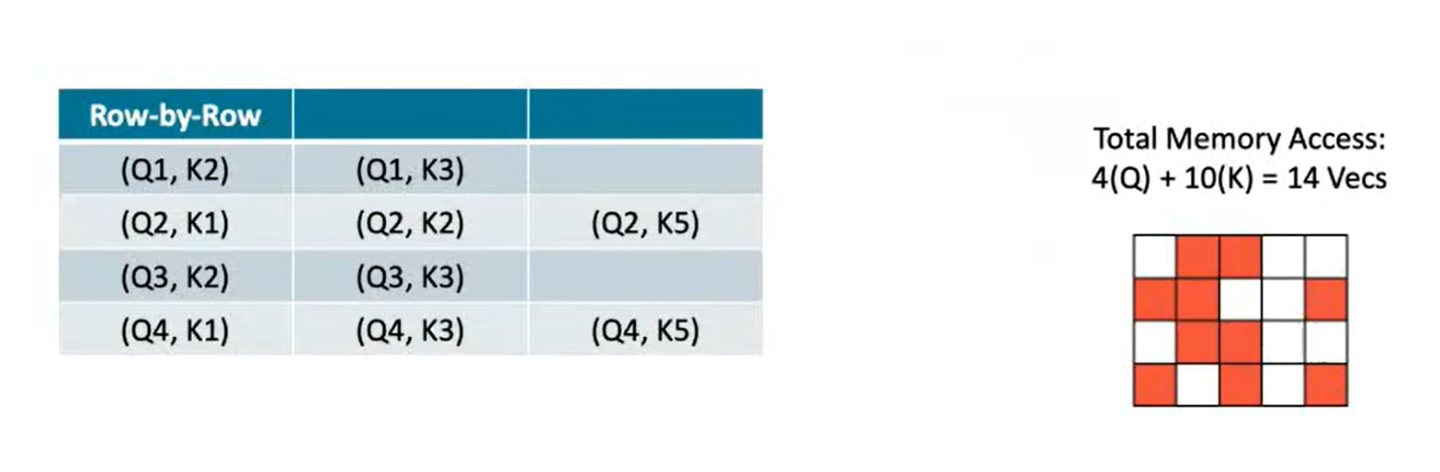
Token-Parallel Sparse Attention
Naïve way – compute the output matrix row by row, from left to right

Slide 22
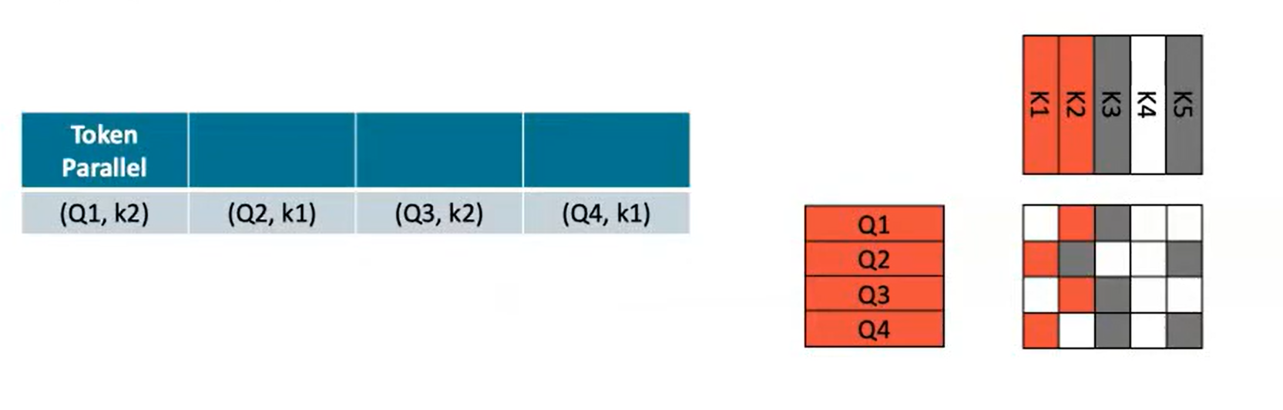
Token-Parallel Sparse Attention
Utilize sparsity, compute output matrix in group of rows, each row from left to right

Slide 23
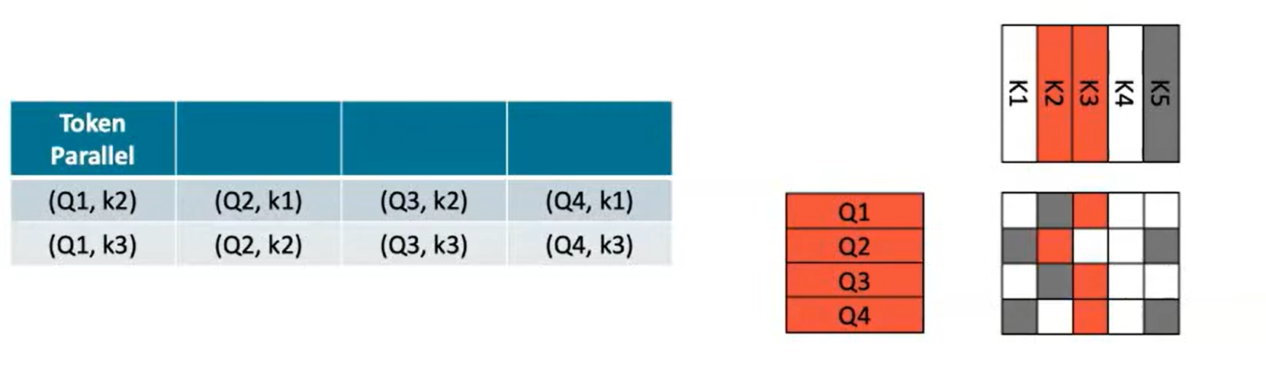
Token-Parallel Sparse Attention
Utilize sparsity, compute output matrix in group of rows, each row from left to right

Slide 24
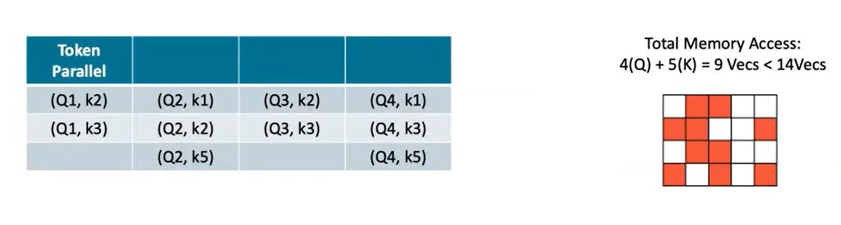
Token-Parallel Sparse Attention
Utilize sparsity, compute output matrix in group of rows, each row from left to right

Slide 25
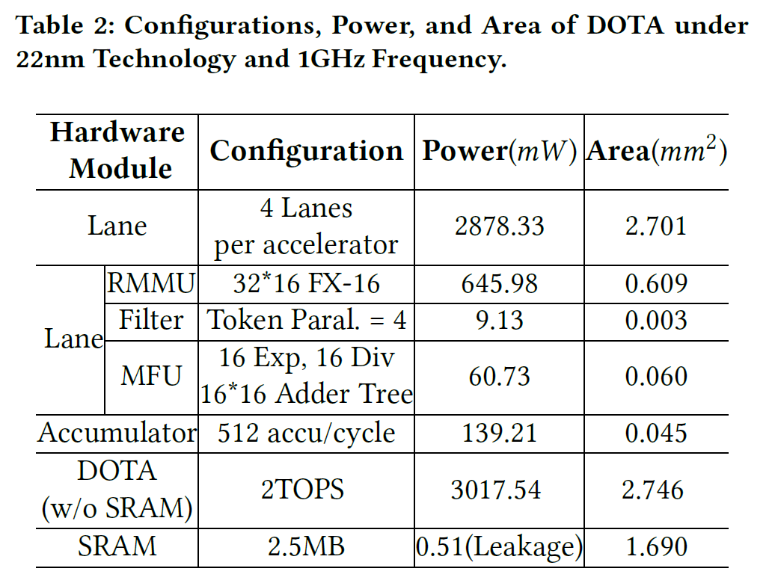
Hardware Configuration
Notes:
NVIDIA V100 GPU

Slide 26
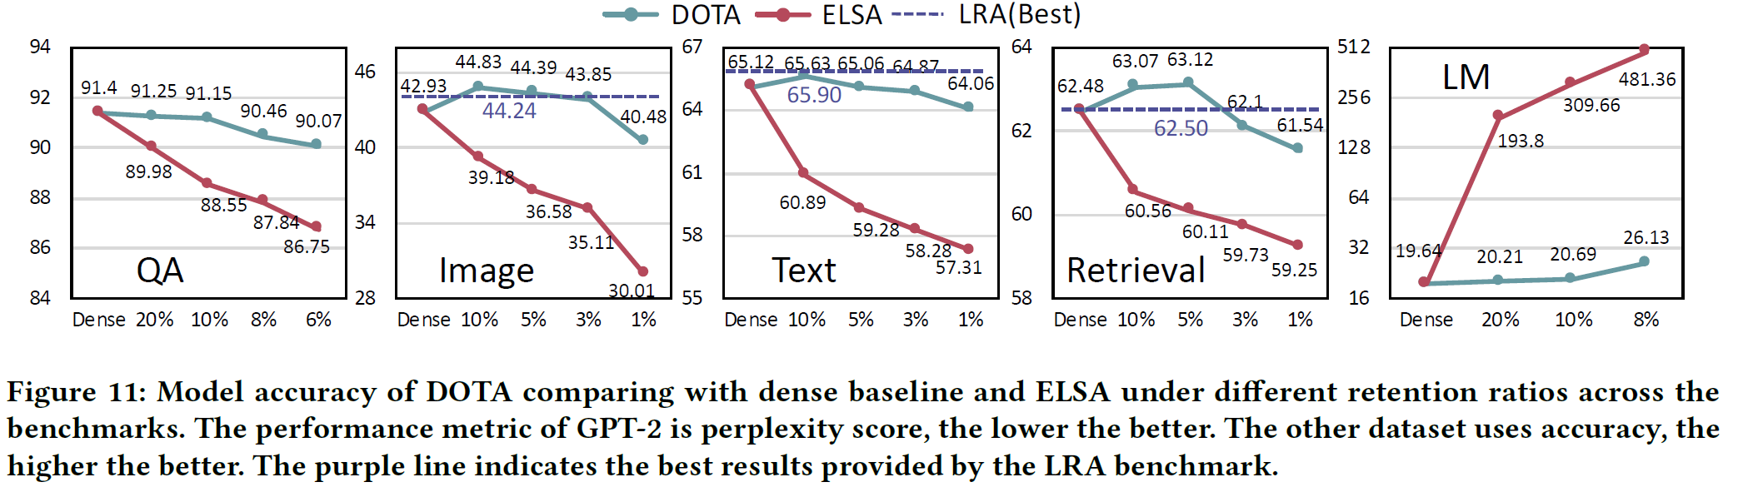
Evaluation: Model Accuracy
Comparable accuracy with dense models under 90-95% sparsity
Much better accuracy-sparsity trade-off than prior art (ELSA)
Notes:
NVIDIA V100 GPU

Slide 27
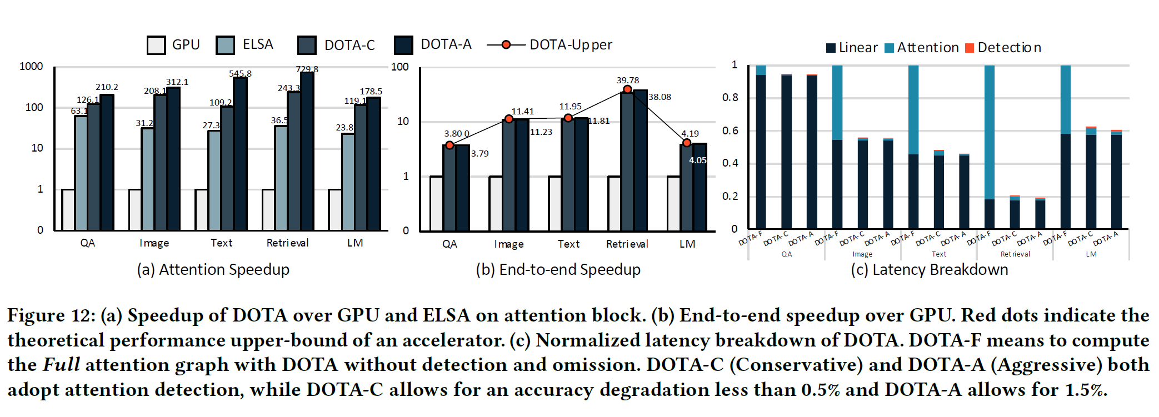
Evaluation: Speedup and Latency Breakdown
Notes:
NVIDIA V100 GPU

Slide 28
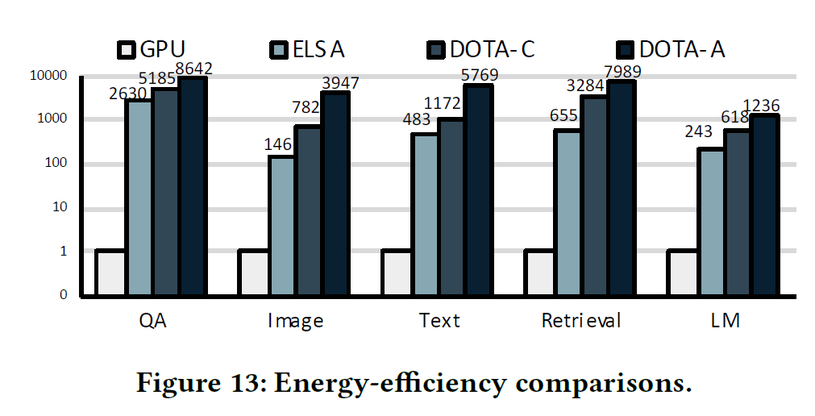
Evaluation: Energy Efficiency
Notes:
NVIDIA V100 GPU

Slide 29
Conclusion
Proposed way to leverage weak attention connection to reduce cost of self-attention mechanism
Light weight detection network and joint optimization
Unified hardware-software co-design
Speedup, energy-efficient with negligible accuracy degradation

Slide 30
Thank you for your attention!
Questions ??
adevkota2@uh.edu

